Slide 1

Covid 19 - New Resources
on Vaccination Campaign
in São Paulo City
Vlamir Bachrany
June/2021

Slide 2
Where?
São Paulo

Slide 3
Context
The COVID-19 pandemic in Brazil is part of the ongoing pandemic of coronavirus disease 2019;
The virus was confirmed to have spread to Brazil on 25 February 2020;
As of June 2021, Brazil, with over 17 million confirmed cases and over 500,000 deaths;
It has the third-highest number of confirmed cases …..
and second-highest death toll from COVID-19 in the world;
São Paulo with 830,000 confirmed cases and 32,500 deaths,

Slide 4
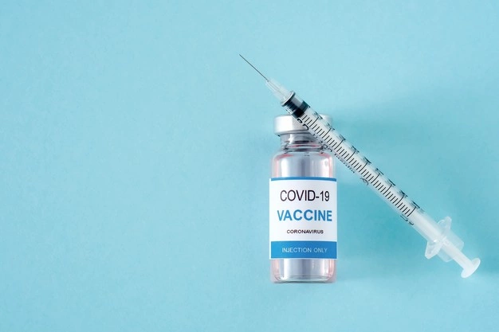
Business Problem
Government needs to carry out a mass vaccination on the population;
Needs speed of vaccination to stop this pandemic;
Vaccination near the citizen’s home – minimum travel
Adequate infrastructure and qualified professionals;
Capillarity;

Slide 5
Data ingestion
IBGE
Foursquare API
IBGE
Geospatial Data
Venues Data
UBS Population Attendance
The .csv file has coordinates of all cities from Brazil. First, the data was cleaned and reduced until we have only data from São Paulo city.
Venues data were obtained from Foursquare API, to explore pharmacies, their location in every borough and UBSs (Basic Health Unit) address.
In this case, I collected the latest UBS (Basic Health Unit) population attendance data from IBGE site, according to each UBS latitude and longitude.

Slide 6
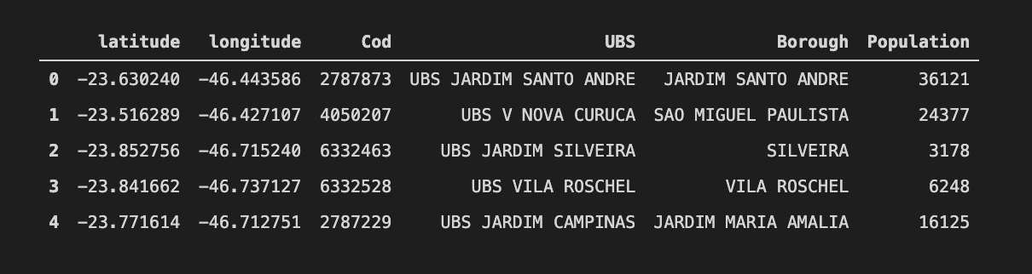
Master Data
Main Attributes:
Latitude,
Longitude,
UBS Code,
UBS Name,
Borough ,
Population (UBS attendance).

Slide 7
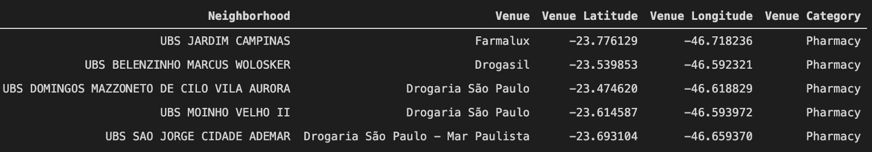
Foursquare Pharmacies
Considerations:
Foursquare API explored the UBS’s boroughs and collected the closest pharmacies among venues;
The limit was 1 mile (1.600 meters) for each UBS, following their geometric coordinates information.

Slide 8
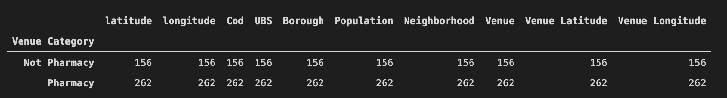
Clustering Method
Classification Pattern
It was adopted two types of classification, related to the presence of Pharmacies or absence around UBS’s boroughs;
The presence or the absence of pharmacies were collected from Foursquare data analysis;
There isn’t pharmacies in 156 UBSs.

Slide 9
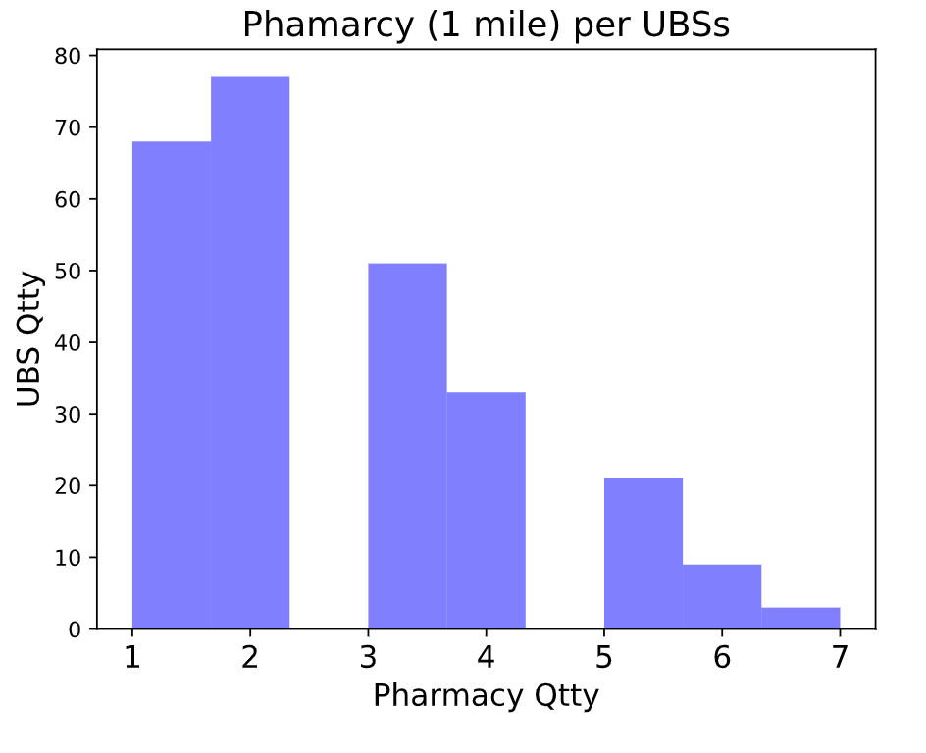
Distribution of Pharmacies Quantity
Distribution Pattern
Total of UBSs: 418
156 UBSs don’t have pharmacies near their borough
In this chart, we can observe only 46% (194) of UBSs have two or more pharmacies in their borough

Slide 10
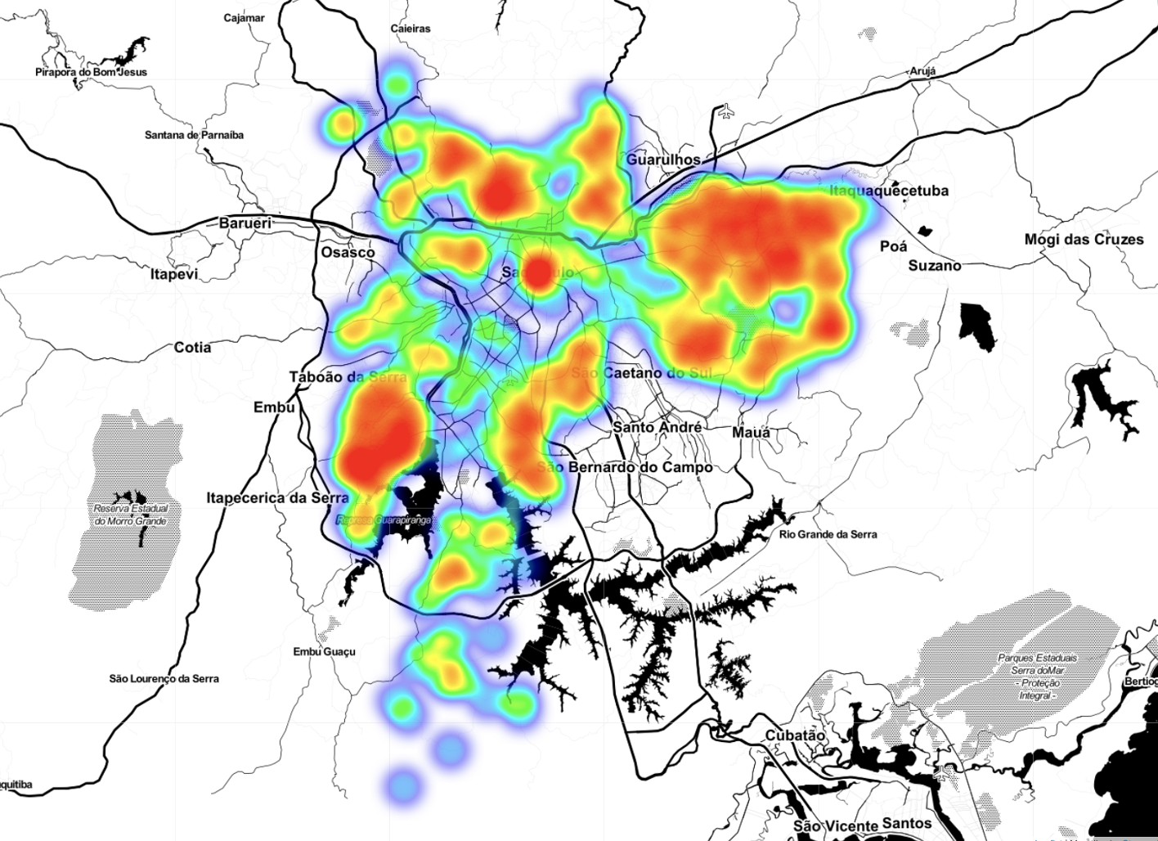
UBSs Concentration Among São Paulo city
Heat Map - UBS Distribution
We noticed the major part of UBSs is located on East, North and South-west zones;
This result makes sense, when we know that these regions have a high population density.

Slide 11
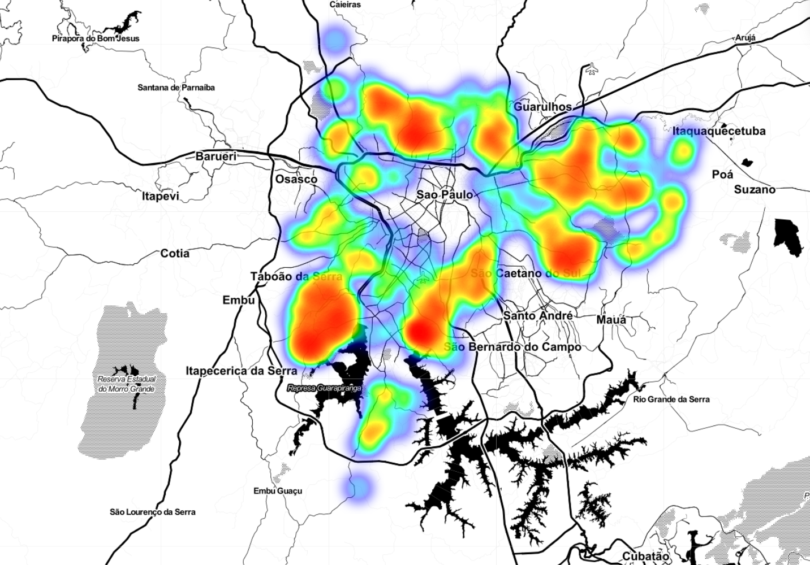
Many Pharmacies Around: More than 2 Pharmacies
Heat map: High pharmacy density
We observed all UBSs which presented more than two pharmacies.
Blue and Green areas present also more than two pharmacies
Red areas shows high density of UBSs together with high density of pharmacies

Slide 12
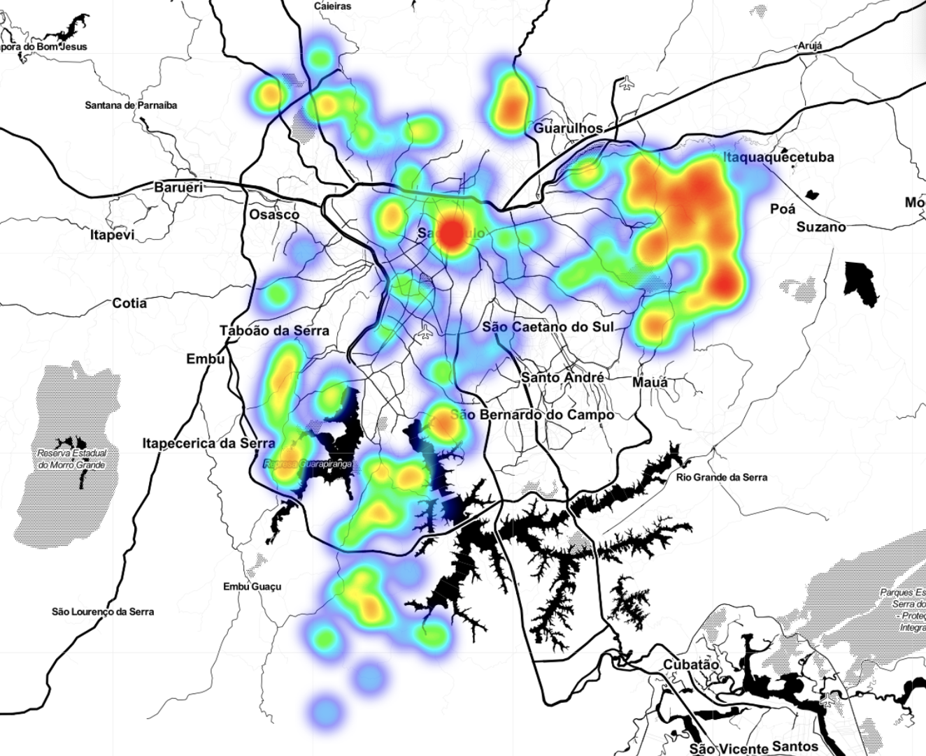
Few Pharmacies Around: Absence or One Pharmacy
Heat map: Low pharmacy density
We observed all UBSs which presented less than two pharmacies around;
Blue and White areas present one or absence of pharmacies;
Red areas also present a low quantity of pharmacies, but a high density of UBSs.

Slide 13
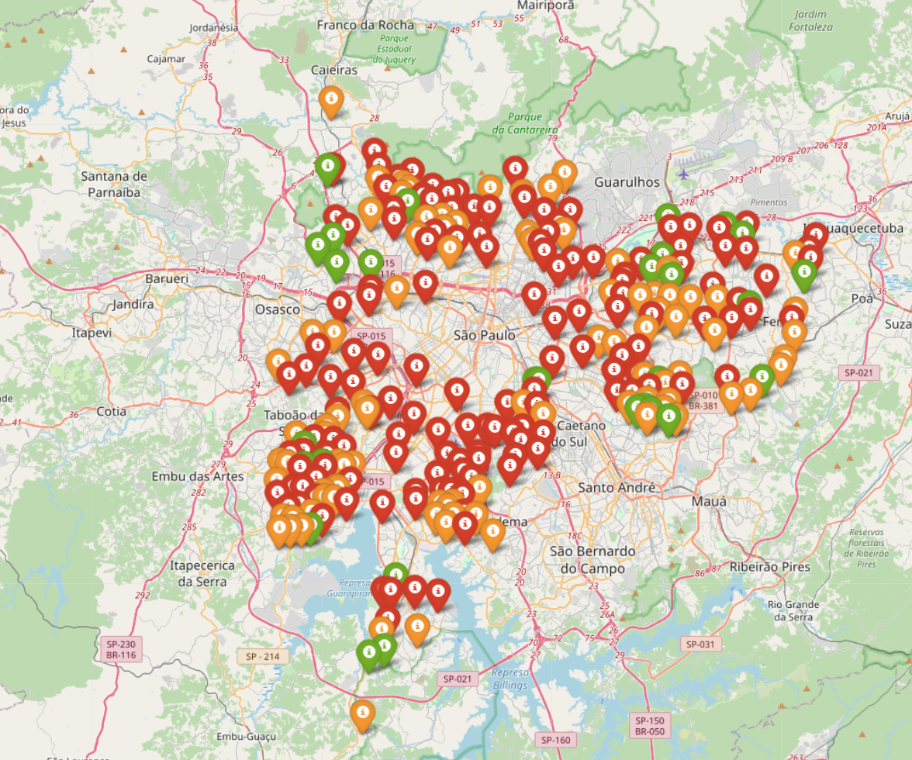
High Pharmacy & High Population Density
Population Attendance Distribution for High Pharmacy Density
Red markers show UBSs with a high population attendance density and high pharmacies quantity among their boroughs;
Yellow and Green markers present a medium and low density of population attendance density, respectively. They also have high pharmacy density.

Slide 14
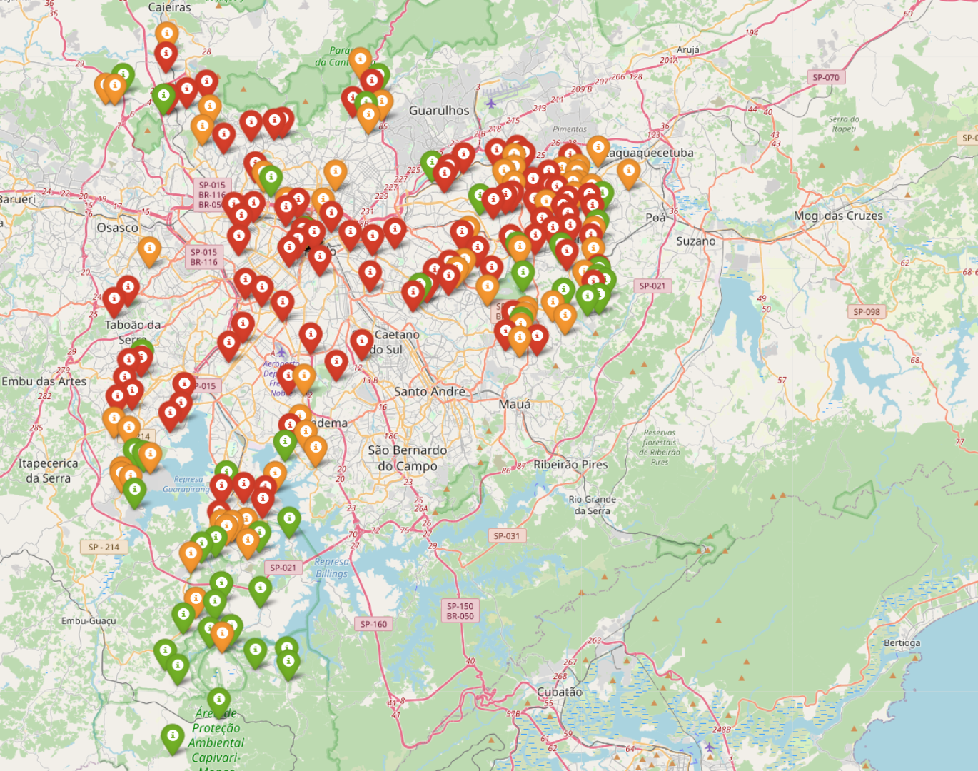
Low Pharmacy & High Population Density
Population Attendance Distribution for Low Pharmacy Density
Red markers show UBSs with a high population attendance density and few pharmacies quantity among their boroughs;
Yellow and Green markers present a medium and low density of population attendance density, respectively. They also have low pharmacy density.

Slide 15
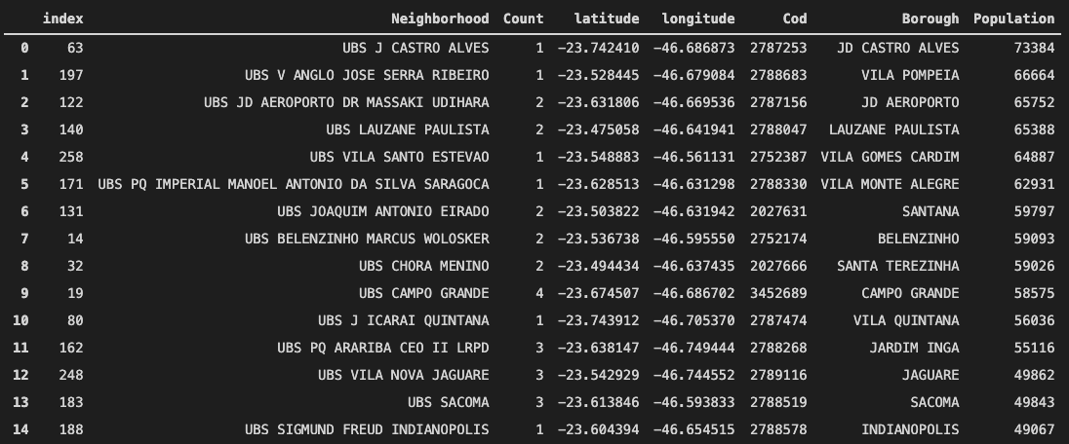
Top 15 UBS: High Population and High Pharmacy Density

Slide 16
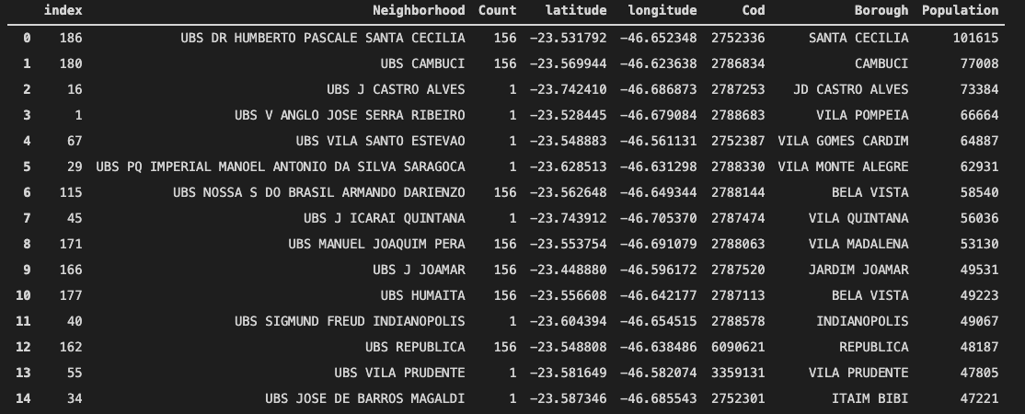
Top 15 UBS: High Population and Low Pharmacy Density

Slide 17
Results & Discussion
What are the benefits when using pharmacies in vaccination?
24 x 7 vaccination service
Vaccination near the citizen's home - minimum travel
Capillarity
Scheduling - less waiting time in line
Verification for clinical parameters (when applicable)
Adequate infrastructure and qualified professionals in any weather condition
Places for special assistance for women, for people with pre-existing problems (allergy, mobility, special health care, etc)
“The pharmacy offers more access to the population, with quality, safety and availability compatible with what the population needs.”

Slide 18
Results & Discussion
When we don’t have pharmacies around, what is possible to do?
Vaccination drive-thru into supermarkets and sports arenas;
Mobile vaccination attendance;
Use schools and universities places to receive population to vaccinate.
What else can we do?
Population should ask Federal Government to buy enough vaccines to cover the vaccination goals;
Train professionals to attend vaccination demand;
Marketing Campaign to encourage people in relation to get vaccinated (first and second dose);
Vaccine development with Brazilian technology ;
Federal Government be prepared for vaccination campaigns in the coming years.

Slide 19
Thanks for excellent Course !
Vlamir Bachrany
You can find me at:
@vbachran on GitHub

